Slide 1
Ear Notching
National Junior Swine Association
Skillathon Resource

Slide 2
Learning Objectives
Understand the numbering system for ear notches
Identify and assign ear notches to specific animals
Understand the role of the ear notching system in today’s industry.

Slide 3
Why Do We Notch?
Ear notching primarily serves as a form of identification.
Think of an ear notch like the pig’s first and last name.
-The right ear identifies the litter number (last name).
**Farms assign this number to each litter
-The left ear identifies the individual pig within that litter (first name).
This is what the tool
looks like that is used
to ear notch pigs

Slide 4
Why Do We Notch?
Ear notches are typically made within the first few days of birth.
Ear notches help breeders maintain accurate records in regards to registration and in regards to health records on the farm (i.e. vaccination records, etc.)
Pigs are notched using an ear notcher (the tool seen below).

Slide 5
Reading Notches
When we are looking at a pig, we read right to left.
The litter number will always be mentioned or written first followed by a dash/hyphen (-) and then the individual pig number.
Some larger breeding operations can have very large litter numbers because there are a lot of litters born on their farm every year. These can be tricky at times, but by practicing the numbering system on the next few slides, you can become a pro in no time.

Slide 6
Ear Notching System

Slide 7
Adding Ear Notches
We can use multiple notches of the same number to add up to the total that we need.
EXAMPLE: Say we have a pig with the ear notch of 33-7. This ear notch would be made by making two notches in the “3” location on the left ear, and one notch in the “1” location on the left ear (3+3+1=7). In the right ear, one notch would be made in the “27” region, and two notches would be made in the “3” region (27+3+3=33).

Slide 8
Knowledge Check!
See what all you learned about ear notching!
Click to Begin

Slide 9
1. The right ear identifies the individual pig in the litter.
TRUE
FALSE

Slide 10
Try Again!
Think back to what each ear represents in an ear notch.
Back

Slide 11
CORRECT!
When doing ear notches, the right ear identifies the litter number and the left ear identifies the individual pig in that litter.
Next Question!

Slide 12
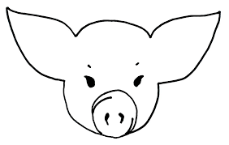
2. What is the litter number of this pig?
85
87
83

Slide 13
Try Again!
Go back and review the notching numbers if you need to!
Back

Slide 14
CORRECT!
The litter number is 85. We look at the right ear and see an 81, a 3, and a 1.
81 + 3 + 1 = 85
Next Question!

Slide 15
3. What individual pig is this in the litter?
5
7
9

Slide 16
Try Again!
Go back and review the notching numbers if you need to!
Back

Slide 17
CORRECT!
The individual pig number is 5. We look at the left ear and see a 3, and two notches in the 1 area.
3 + 1 + 1= 5
Next Question!

Slide 18
4. What is the ear notch of this pig?
6-9
6-10
10-6

Slide 19
Try Again!
Go back and review the notching numbers if you need to!
Back

Slide 20
CORRECT!
We look at the litter number and see:
9 + 1 = 10
We look at the individual pig number and see:
3 + 3 = 6
10-6
Next Question!

Slide 21
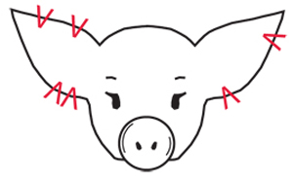
5. What is the proper ear notch of this pig?
5-20
38-4
4-38
20-5

Slide 22
Try Again!
Go back and review the notching numbers if you need to!
Back

Slide 23
CORRECT!
Right Ear: 27 + 9 +1 + 1 = 38
Left Ear: 3 + 1 =4
38-4
Next Question!

Slide 24
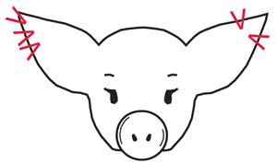
6. What is the proper ear notch of this pig?
87-12
12-87
90-12
84-9

Slide 25
Try Again!
Go back and review the notching numbers if you need to!
Back

Slide 26
CORRECT!
Right Ear: 81 + 3 + 3 = 87
Left Ear: 9 + 3 = 12
87-12
END QUIZ

Slide 27
Congratulations!
You have completed the
“Ear Notching” skillathon resource.
Practice the other categories
to expand your industry knowledge.

